Slide 1
Basics of Quantum Mechanics - Heisenberg Uncertainty Principle
One cannot unambiguously specify the values of particle's position and its momentum for a microscopic particle, i.e.
Position and momentum are, therefore, considered as incompatible variables.
The Heisenberg uncertainty principle strikes at the very heart of the classical physics => the particle trajectory.

Slide 2
Heisenberg Uncertainty Principle
It states that only one of the “position” or “momentum” can be measured accurately at a single moment within the instrumental limit.
or
It is impossible to measure both the position and momentum simultaneously with unlimited accuracy.
Δx →
Δp_{x} →
uncertainty in position uncertainty in momentum
The product of Δx & Δp of an object is greate than or equal to
x

Slide 3
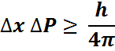
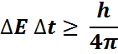

Slide 4
Quantum Mechanics

Slide 5
Basics of Quantum Mechanics
What makes quantum mechanics is the physical interpretation of the results that are obtained
Quantum Mechanics is nothing more but linear algebra and Hilbert spaces
Quantum physicists are interested in all kinds of physical systems (photons, conduction electrons in metals and semiconductors, atoms, etc.). State of these rather diverse systems are represented by the same type of functions
➔ STATE FUNCTIONS.

Slide 6
Basics of Quantum Mechanics
First postulate of Quantum mechanics:
Every physically-realizable state of the system is
described in quantum mechanics by a state function ‘ψ’
it contains all accessible physical information about the system in that state.
Physically realizable states
➔ states that can be studied in laboratory
Accessible information
➔ the information we can extract from the wavefunction
State function
➔ function of position, momentum, energy that is spatially localized.

Slide 7
Basics of Quantum Mechanics
If ψ₁ and ψ₂ represent two physically-realizable states of the system, then the linear combination
Ψ = c₁ Ψ₁ + c₂ Ψ₂
where c₁ and c₂ are arbitrary complex constants, represents a third physically realizable state of the system.
Wavefunction ψ(x,t) ➔ position and time probability amplitude
Quantum mechanics describes the outcome of an ensemble of measurements, where an ensemble of measurements consists of a very large number of identical experiments performed on identical non-interacting systems, all of which have been identically prepared so as to be in the same state.

Slide 8
Basics of Quantum Mechanics
Second Postulate of Quantum Mechanics
If a system is in a quantum state represented by a wavefunction ‘ψ’, then
P dV = | Ψ|² dV
is the probability that in a position measurement at time ‘t’ the particle will be detected in the infinitesimal volume dV.
| Ψ(x,t)|² ➔ position and time probability density
The importance of normalization follows from the Born interpretation of the state function as a position probability amplitude.
According to the second postulate of quantum mechanics, the integrated probability density can be interpreted as a probability that in a position measurement at time t, we will find the particle anywhere in space.

Slide 9
Basics of Quantum Mechanics
Therefore, the normalization condition for the wavefunction is:
Limitations on the wavefunction:
Only normalizable functions can represent a quantum state and these are called physically admissible functions.
State function must be continuous and single valued function.
State function must be a smoothly-varying function (continuous derivative).

Slide 10
Basics of Quantum Mechanics
Third Postulate of Quantum Mechanics

Slide 11
Basics of Quantum Mechanics

Slide 12
Basics of Quantum Mechanics
The requirement for two operators to be commuting operators is a very important one in quantum mechanics and it means that we can simultaneously measure the observables represented with these two operators.
The non-commutivity of the position and the momentum operators (the inability to simultaneously determine particles position and its momentum) is represented with the Heisenberg uncertainty principle, which in mathematical form is expressed as:
and can be generalized for any pair of observables.

Slide 13
Wave function
The quantity with which Quantum Mechanics is concerned is the wave function of a body.
Wave function, 'ψ' is a quantity associated with a moving particle. It is a complex quantity.
|Ψ|² is proportional to the probability of finding a particle at a particular point at a particular time. It is the probability density.
|ψ |² =ψ *ψ
ψ is the probability amplitude.
Thus if
ψ = A + iB ψ * = A − iB
then
⇒|ψ |² =ψ *ψ = A² − i² B² = A² + B²

Slide 14
Normalization
|Ψ|² is the probability density.
The probability of finding the particle within an element of volume dτ
|ψ |² dτ
Since the particle is definitely be somewhere, so
∞
∫|ψ |² dτ = 1
∴
Normalization
−∞
A wave function that obeys this equation is said to be normalized.

Slide 15
Properties of wave function
It must be finite everywhere.
If ψ is infinite for a particular point, it mean an infinite large probability of finding the particles at that point. This would violates the uncertainty principle.
It must be single valued.
If ψ has more than one value at any point, it mean more than one value of probability of finding the particle at that point which is obviously ridiculous.
3. It must be continuous and have a continuous first derivative everywhere.
∂ψ ∂ψ ∂ψ
must be continuous
∂x , ∂y , ∂z
4. It must be normalizable.
5. At x = ± infinite, y = ± infinite z = ± infinite
ψ(x,y,z,t) = 0

Slide 16
Ψ(x,t) = sin x
dΨ(x,t)/dx = cos x
Sin²x dx =
x = 0 to pi/2
x = -pi/2 to pi/2
Ψ(x,t) = cos x
x = 0 to pi
Ψ(x,t) = sin x

Slide 18
Linearity and Superposition
If ψ₁ and ψ₂ are two solutions of any Schrodinger equation of a system, then linear combination of ψ₁ and ψ₂ will also be a solution
of the equation.. _{ψ = a ψ}
a ψ
is also a solution
1 1
2 2
Here
a₁ & a₂
are constants
Above equation suggests:
The linear property of Schrodinger equation
ψ₁ and ψ₂ follow the superposition principle

Slide 19
Not only can these atom only EMIT photons of a certain frequency, but they can only ABSORB light of a certain frequency.
Energy
E5
E4
E3
E2
Photon
E1

Slide 20
Energy
After Planck: the particle could have only specific, quantized energies
Vibrating particle

Slide 21
Energy
This means that if a particle is in some energy state, if it is to give up energy in the form of light, it has to give up a definite amount
E1
Light with energy equal to E₁ - E₂= hf
E2
Vibrating particle
Same diagram as last slide except “blown up” to see the spacing better.

Slide 22
ψ → ψ ₁ +ψ ₂
If P₁ is the probability density corresponding to ψ₁ and P₂ is the probability density corresponding to ψ₂
Then due to superposition principle
Total probability will be
P =|ψ |² =|ψ +ψ
1 2
|2
= (ψ ₁ +ψ ₂ ) (ψ +ψ )
*
1 2
= (ψ * +ψ * )(ψ +ψ )
1 2
+ψ *ψ +ψ *ψ
1
2
=ψ *ψ
+ψ *ψ
1 1 2 2
1 2
2 1
P = P + P +ψ *ψ
1 2 1 2
+ψ *ψ
P ≠ P₁ + P₂
Probability density can’t be added linearly
2 1

Slide 23

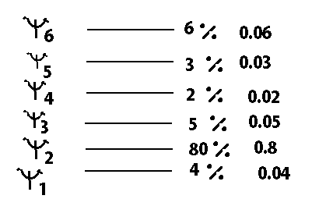
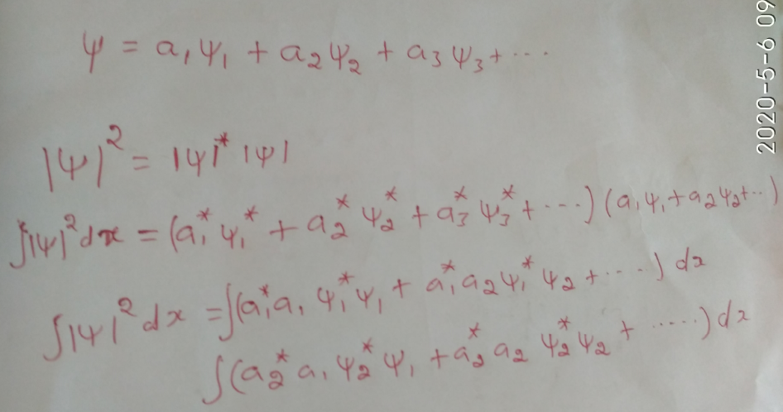

Slide 24
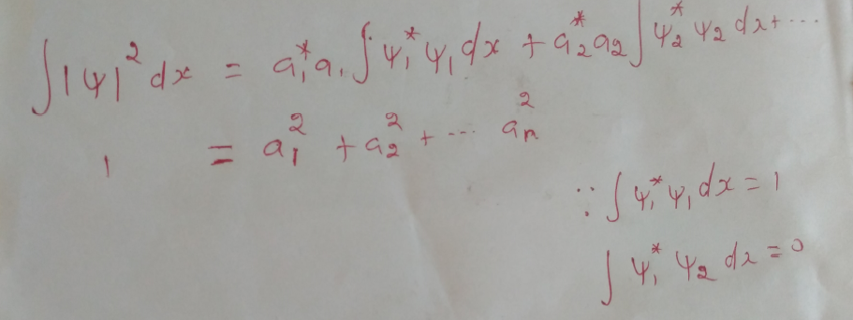
∞
∫ x |ψ |² dx
= 1
−∞

Slide 27
Schrodinger wave equation Derivation From wave equation

Slide 28
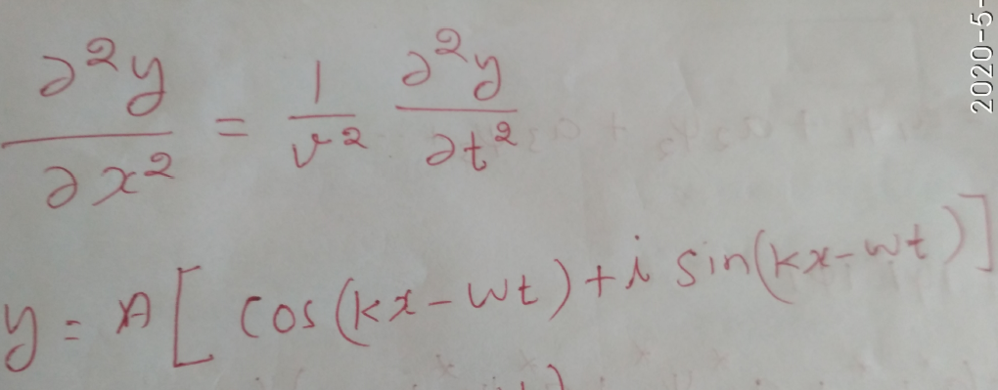
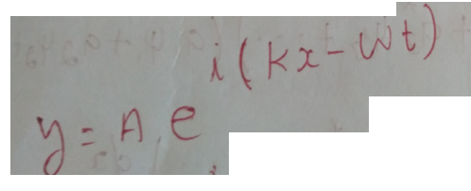
Wave Equation

Slide 29
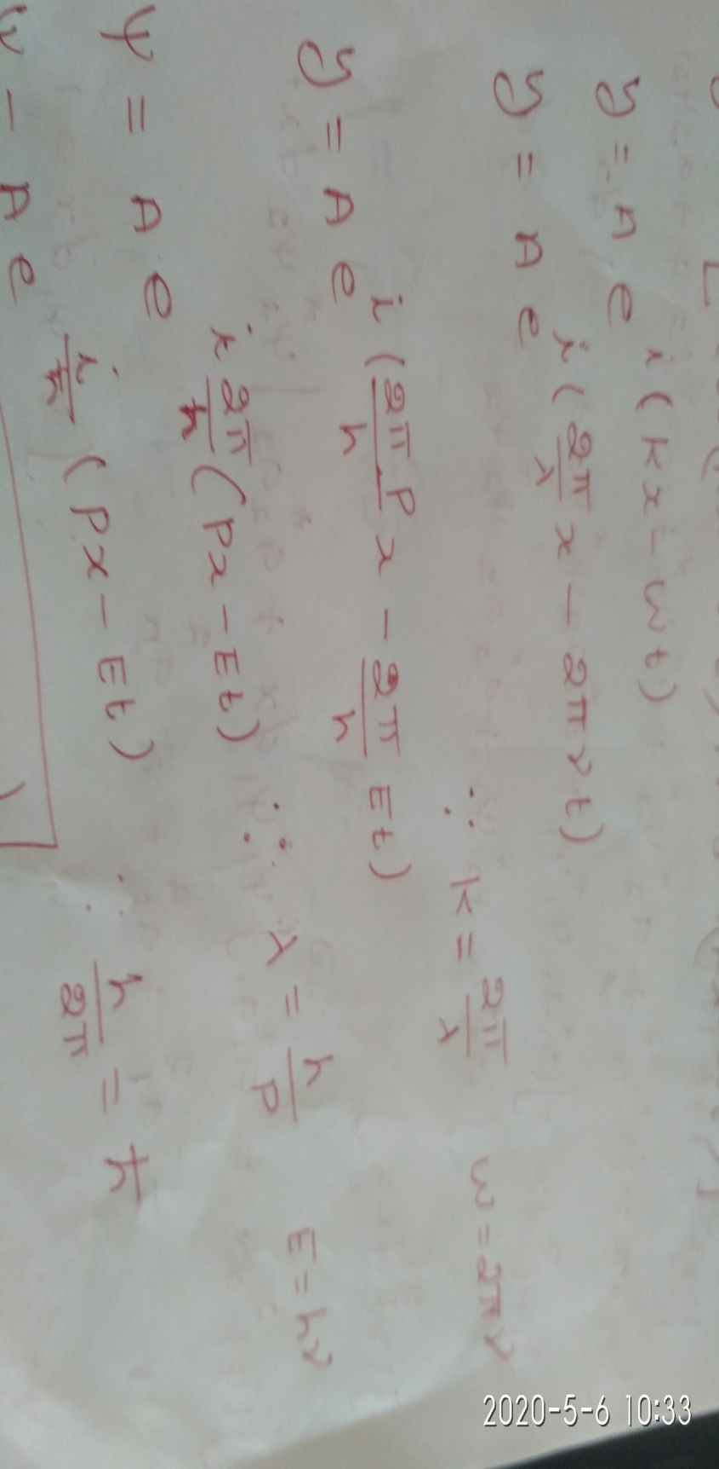

Slide 30
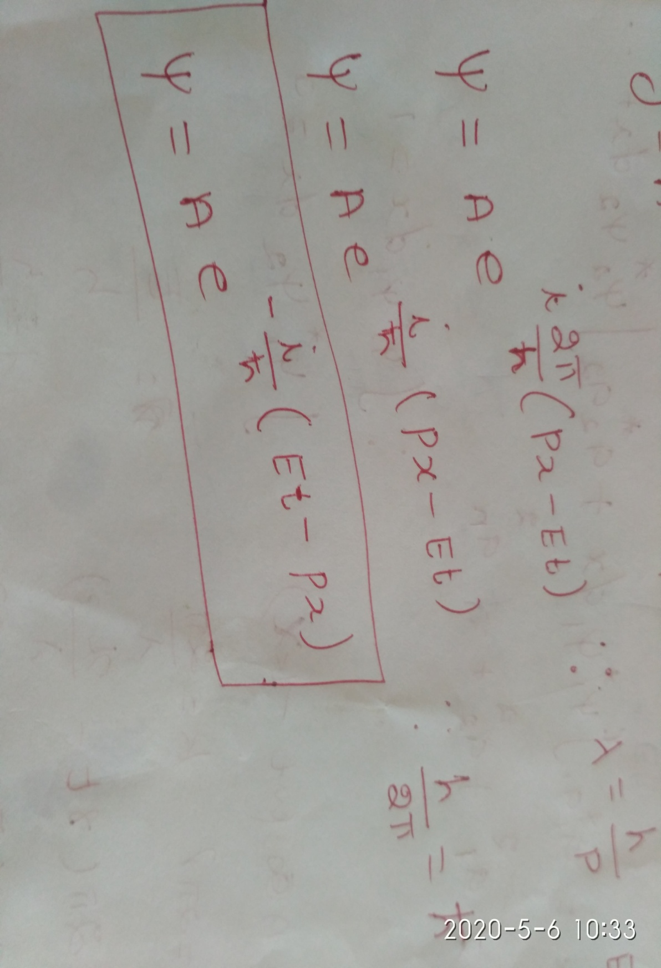

Slide 31
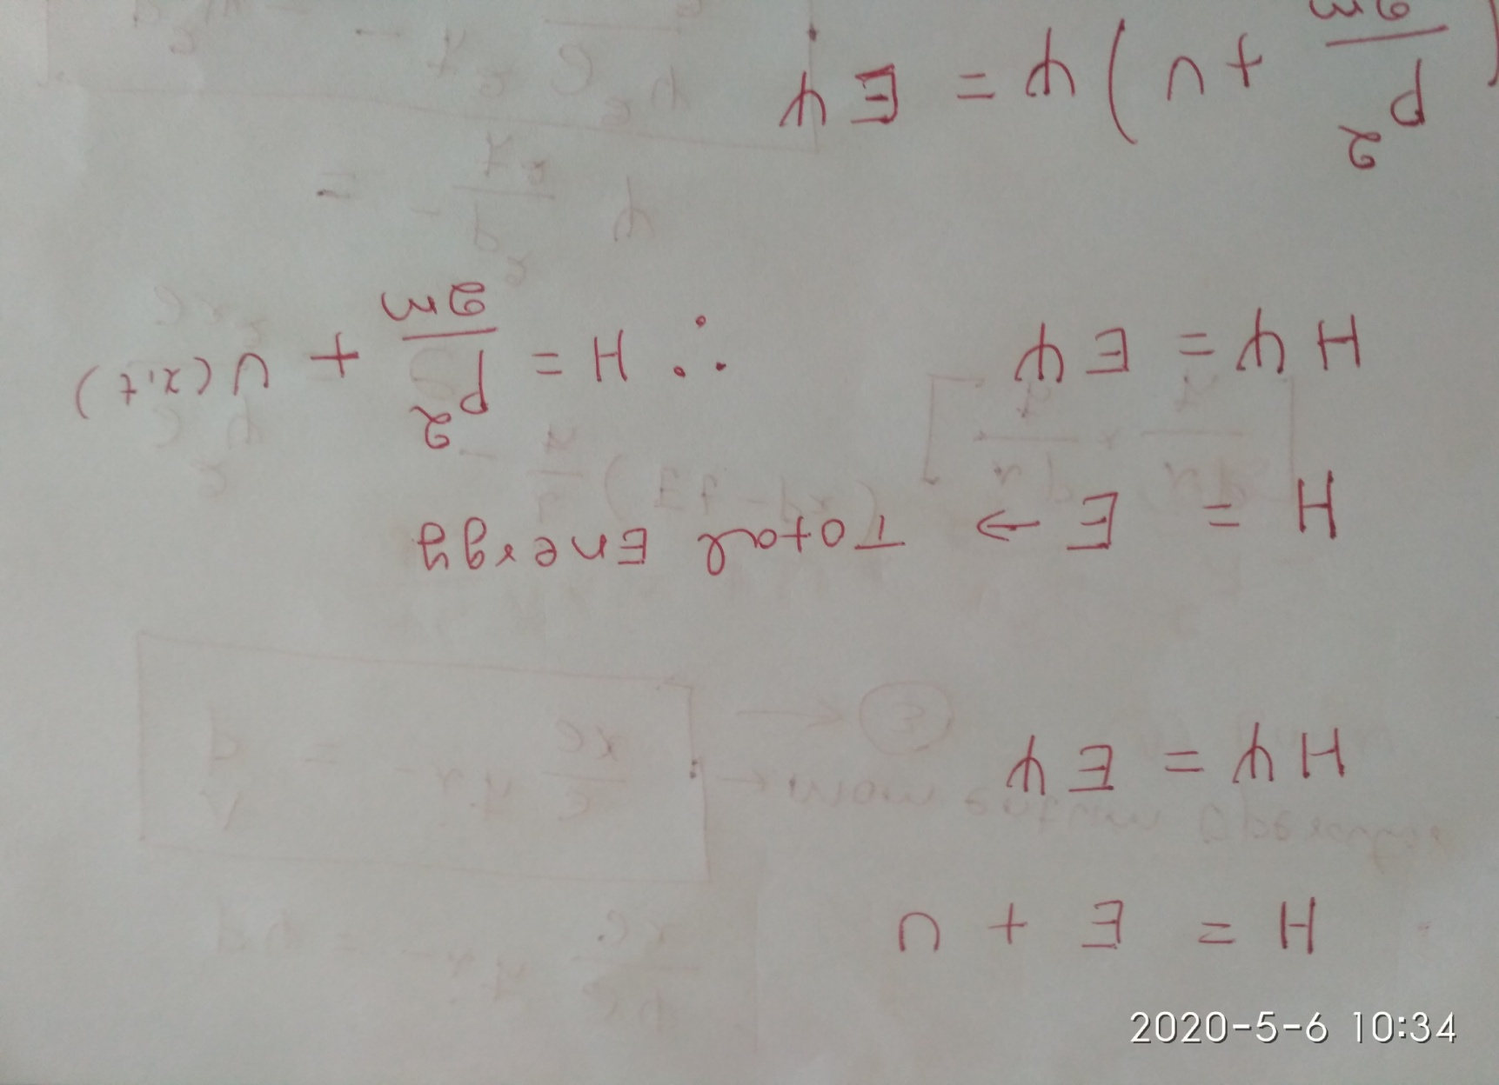
K

Slide 32
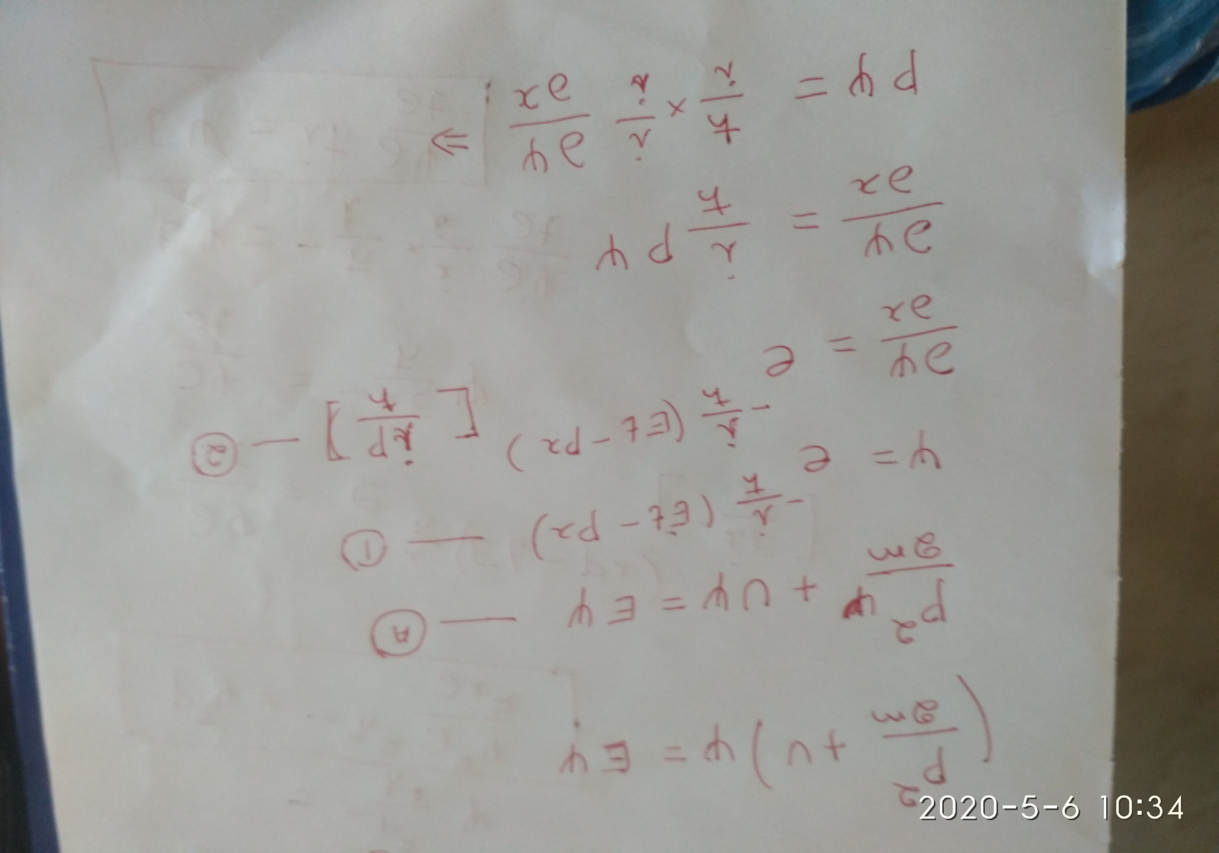

Slide 33
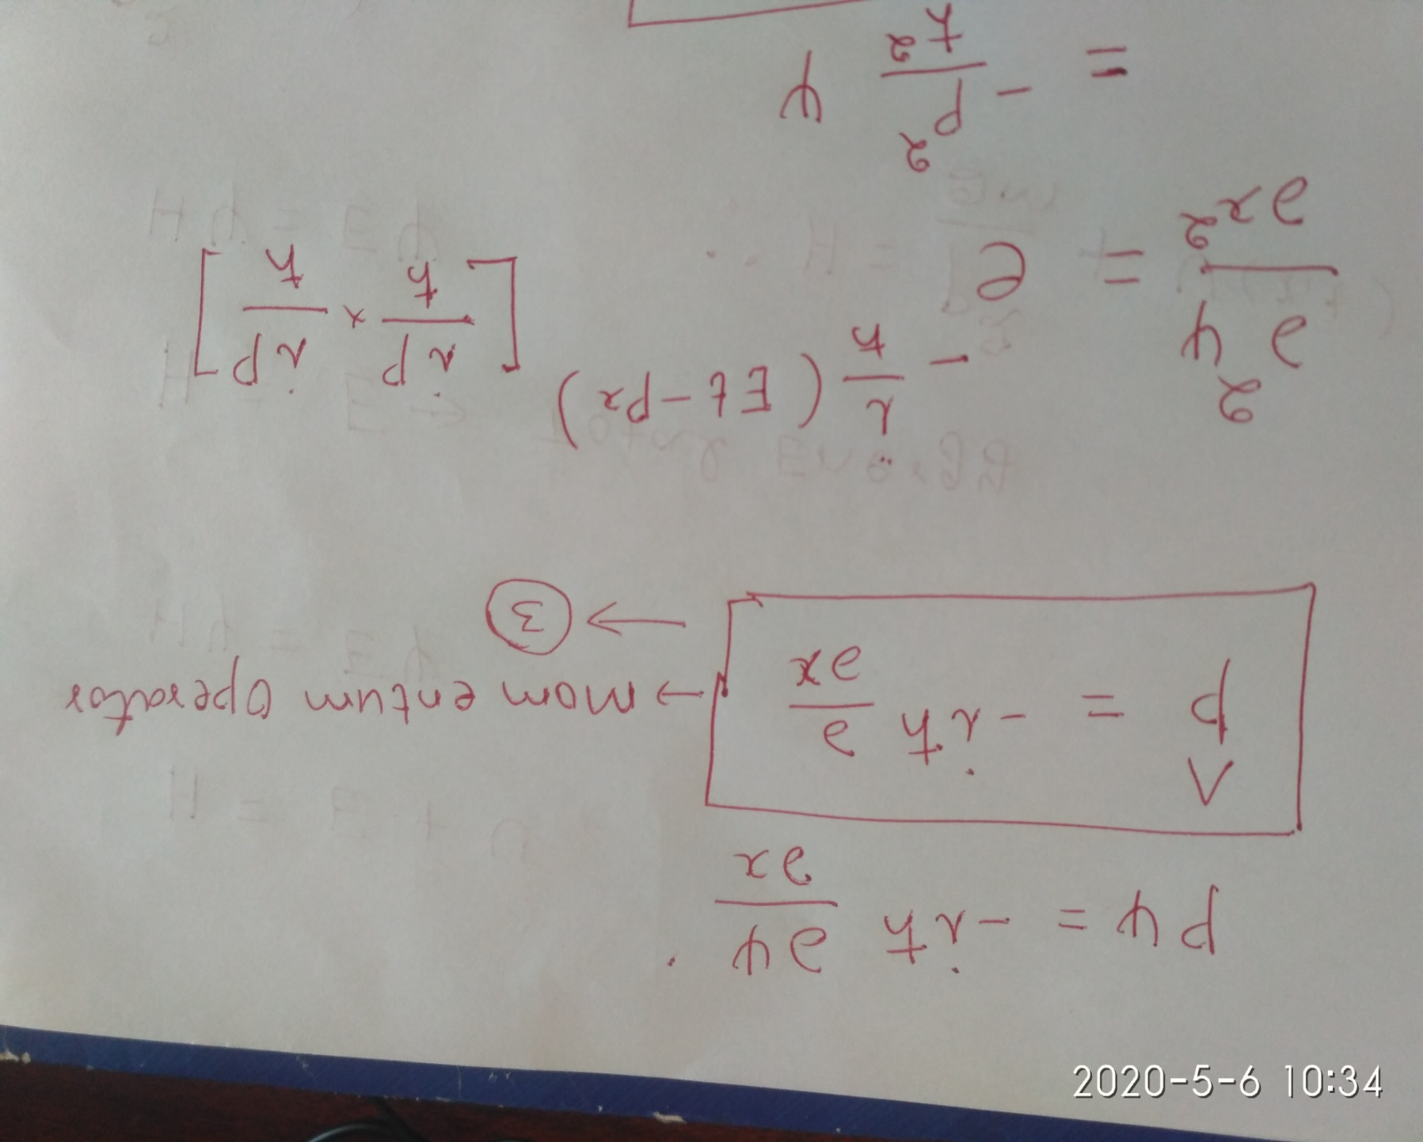

Slide 34
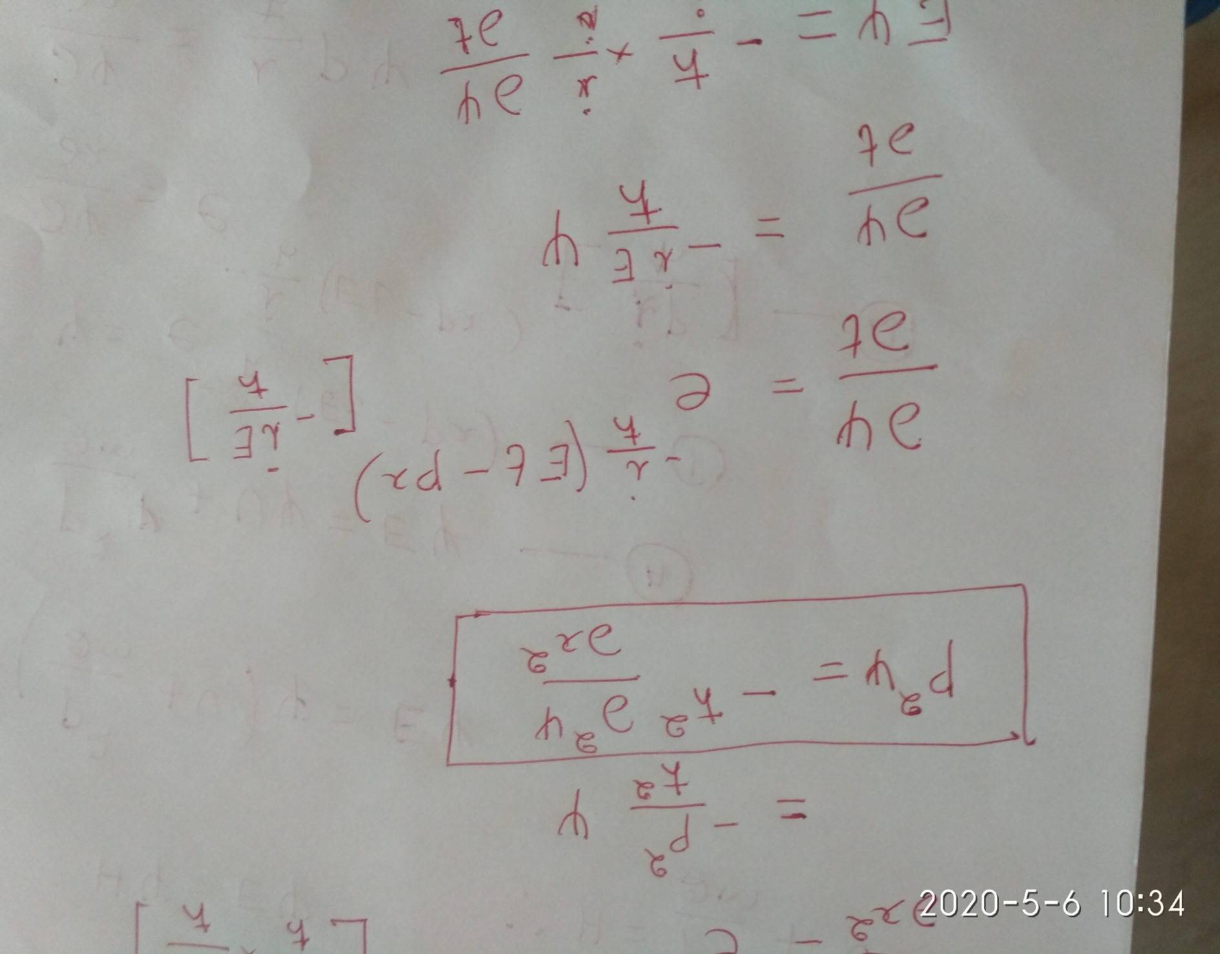

Slide 35
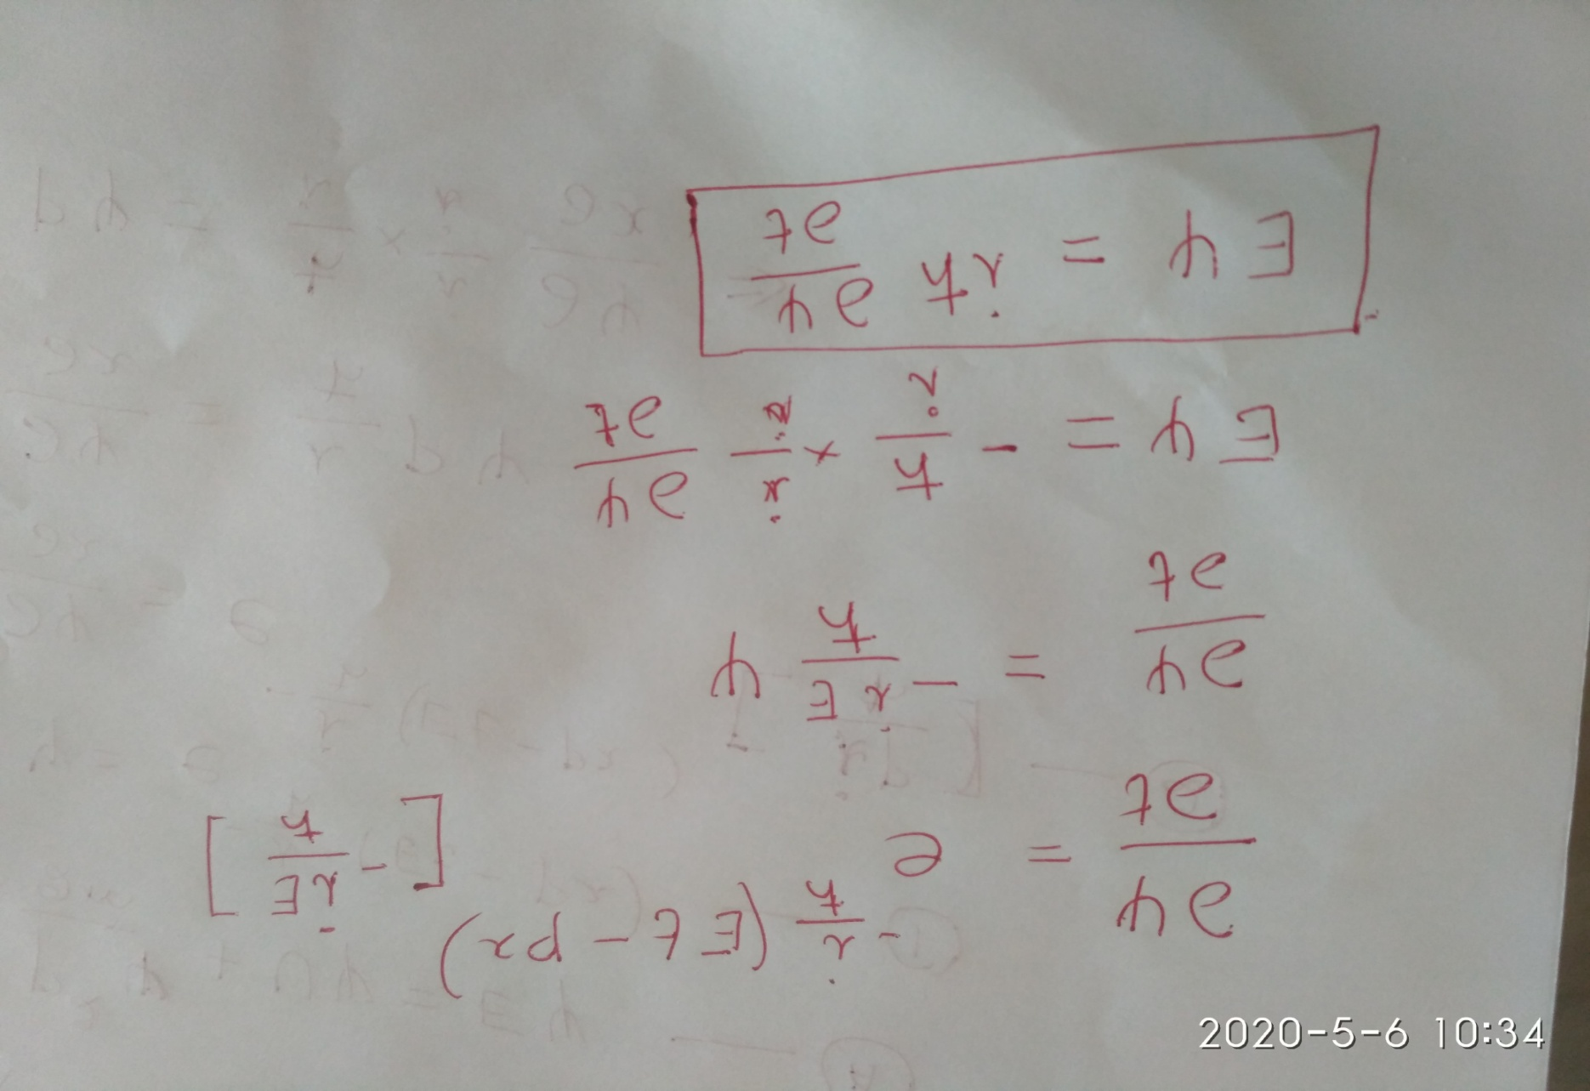

Slide 36
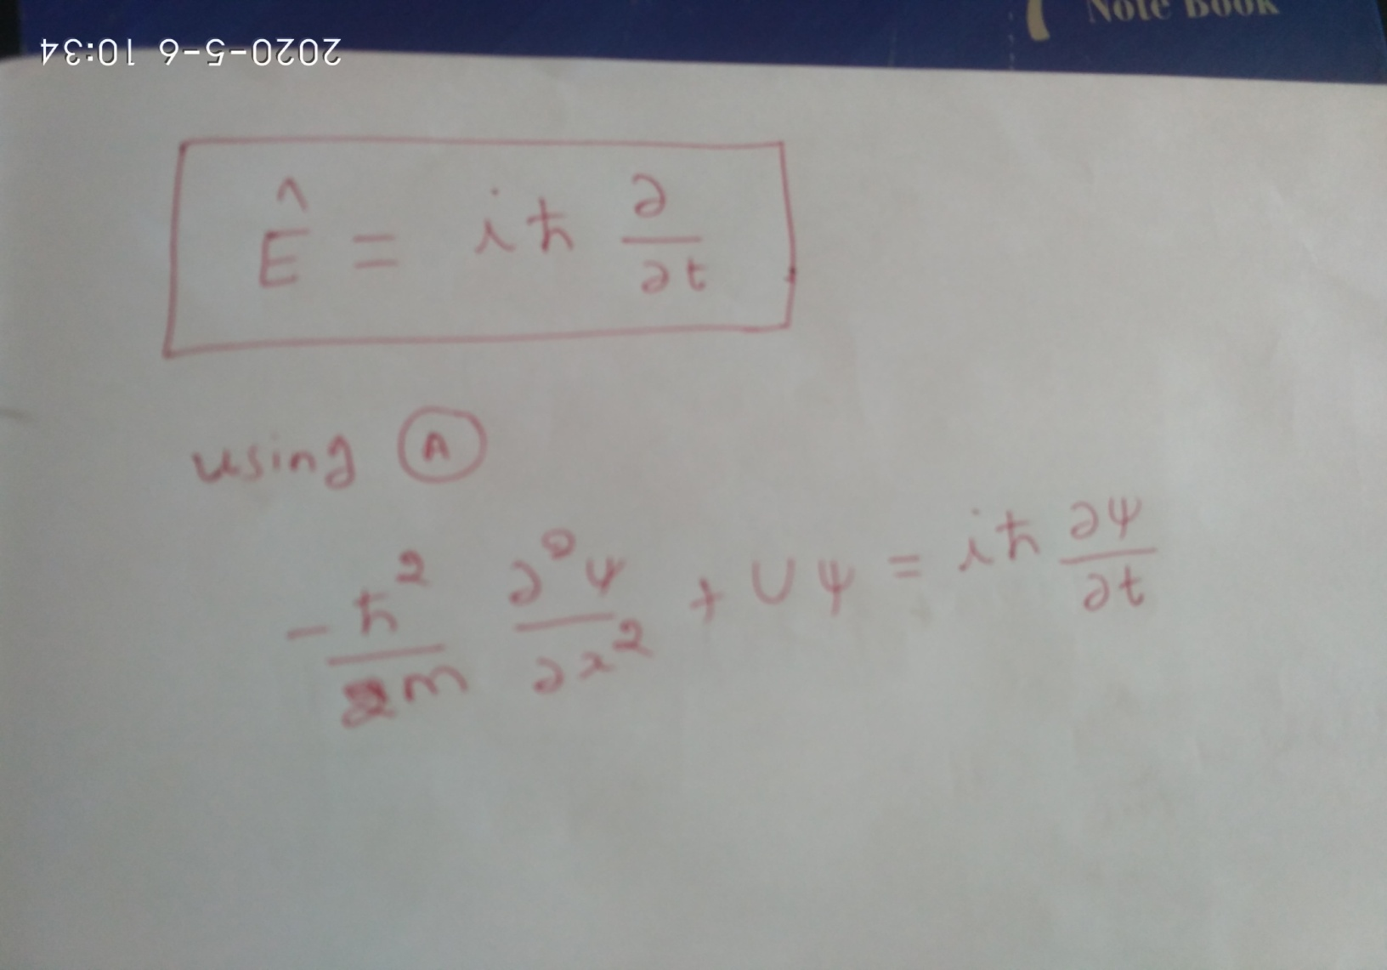

Slide 37
Time-Dependent
Schrodinger Wave Equation
Total E term
P.E. term
PHYSICS NOTATION
K.E. term
Ψ(x,y,z,t) =( ∂²/ ∂x² + ∂²/ ∂y² + ∂²/ ∂z² ) Ψ(x,y,z,t)

Slide 38
Time-Independent Schrodinger Wave Equation

Slide 39
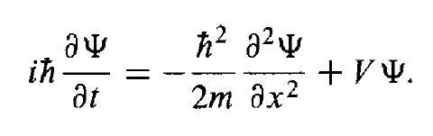
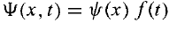
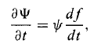
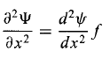
Time Independent Schrodinger wave equation
The time-dependent Schrodinger equation:
Assume that ‘V’ is independent of time ‘t’.
Schrodinger equation can be solved by the method of separation of variables:

Slide 40
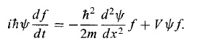
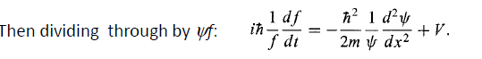
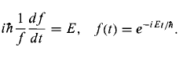
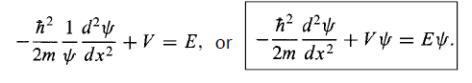
Time Independent Schrodinger wave equation

Slide 41
Applications of Schrodinger wave equations
Particle in a box/ infinitely potential well
Finite potential well
Potential barrier(tunnel effect)
Simple Harmonic Oscillator

Slide 42
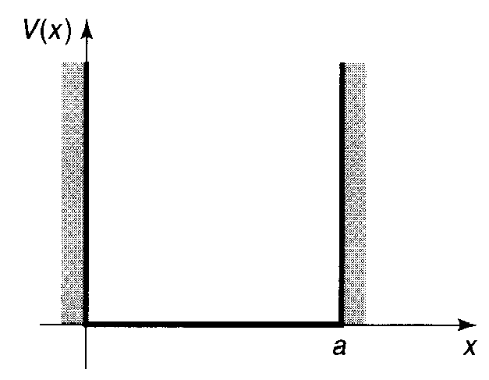
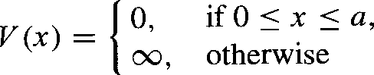
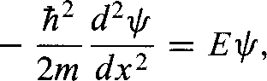
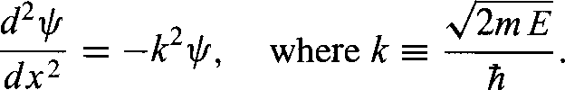
The Infinite Square Well Potential
The infinite square well potential is written as
For instance, take the potential for a conduction electron in a block of metal to be a finite square well. Infinite square well potentials can be used to discuss the quantum mechanical properties particles which are strictly confined within certain region of space.
In the region within the well V=0, hence the Schrodinger equation is given by
or
with E > 0.
The above equation is the (classical) simple harmonic oscillator equation; the general solution is
where A and B are arbitrary constants. Typically, these constants are fixed by the boundary conditions of the problem.

Slide 43
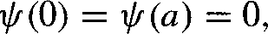
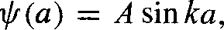
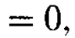
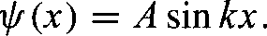
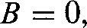
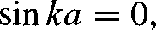
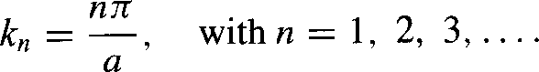
The Infinite Square Well Potential
Both Ψ and dΨ/dx are continuous. But where the potential goes to infinity only the
first of these applies. Therefore
At x = 0
At x = a
So and hence
if A = 0, in which case we're left with the
trivial nonnormalizable solution ψ(x) = 0.
Then,
which means that
But k = 0 is no good. Again, that would imply ψ(x) = 0. The negative solutions give nothing new, since sin(-θ) = - sin(θ) and the minus sign can be absorbed into A. So the distinct solutions are
ψ _{n} ( x) = Asin k_{n} x
for

Slide 44
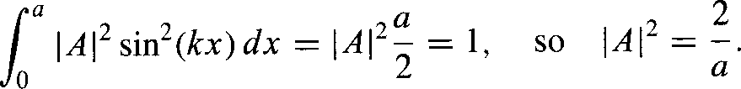
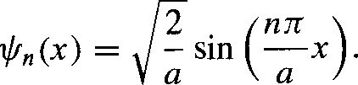
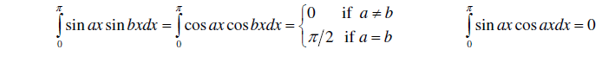
The Infinite Square Well Potential
Through normalization, A can be fixed.
Inside the well, then, the solutions are

Slide 45
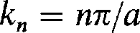
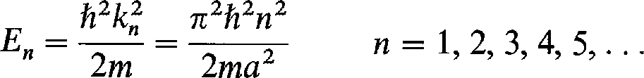
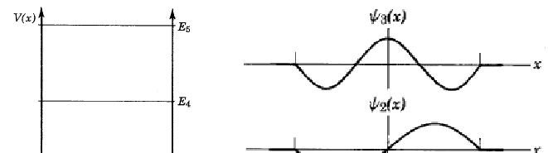
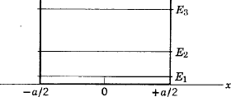
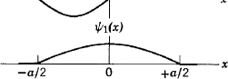
Energy quantization
Since
The total energy of the particle in the well is quantized.
even
Two nodes
One node
odd
Zero node
even
0 a
0 a

Slide 46
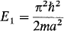
Energy quantization
The first energy eigenvalue for the infinite square well is
This is called the zero-point energy.
It is the lowest possible total energy the particle can have if it is bound by the infinite square well potential to the region 0<x<a.
The particle cannot have zero total energy. The phenomenon is basically a result of the uncertainty principle.
Helium will not solidify even at the lowest attainable temperature ( 0.001°K), unless a very high pressure is applied.

Slide 47
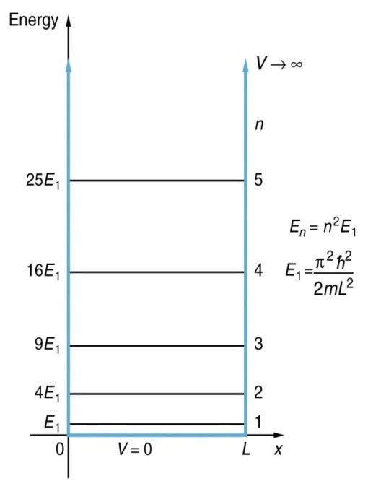
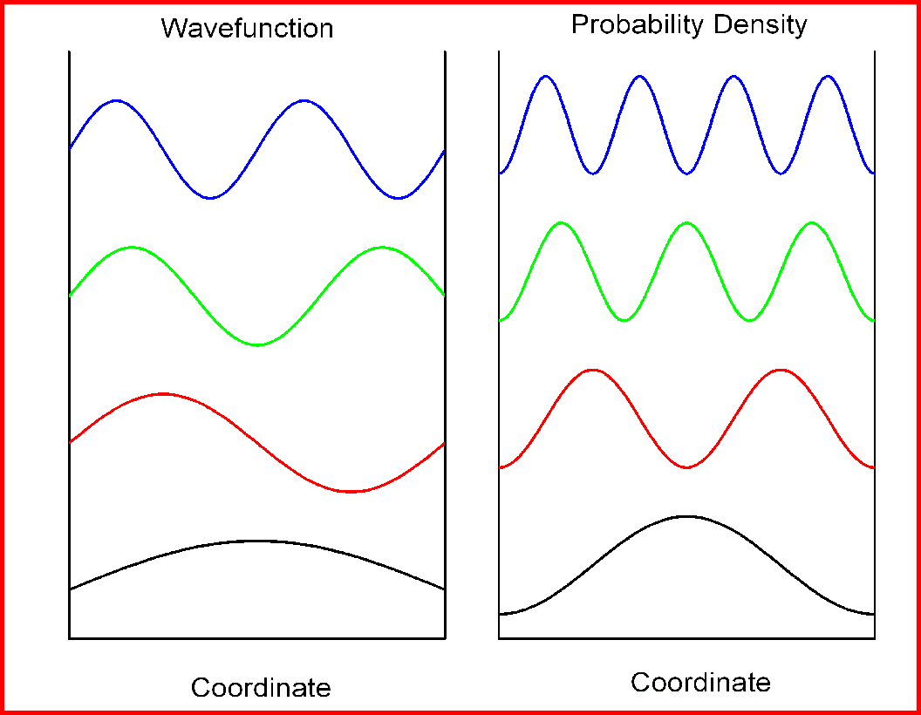
Infinite potential wall
ψ₄
|ψ₄|²
ψ₃
|ψ₃|²
ψ₂
|ψ₂|²
ψ₁
|ψ₁|²

Slide 48
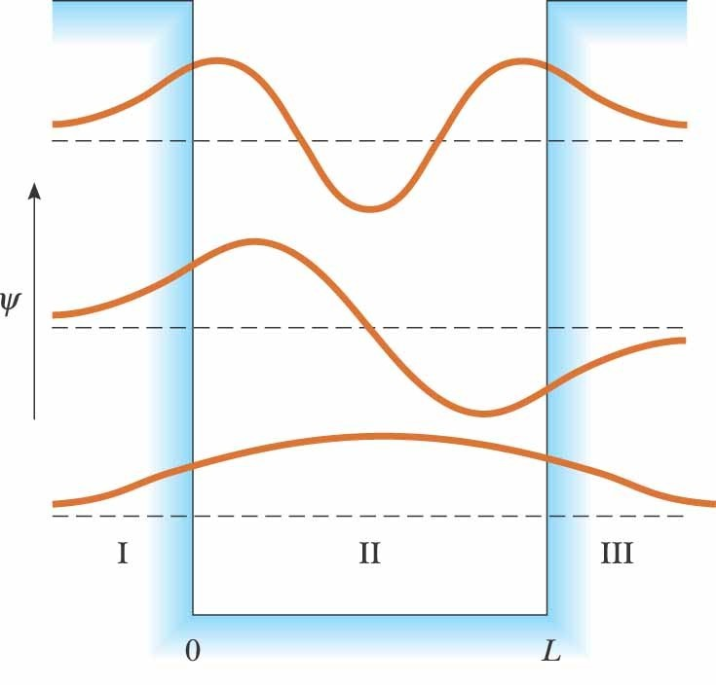
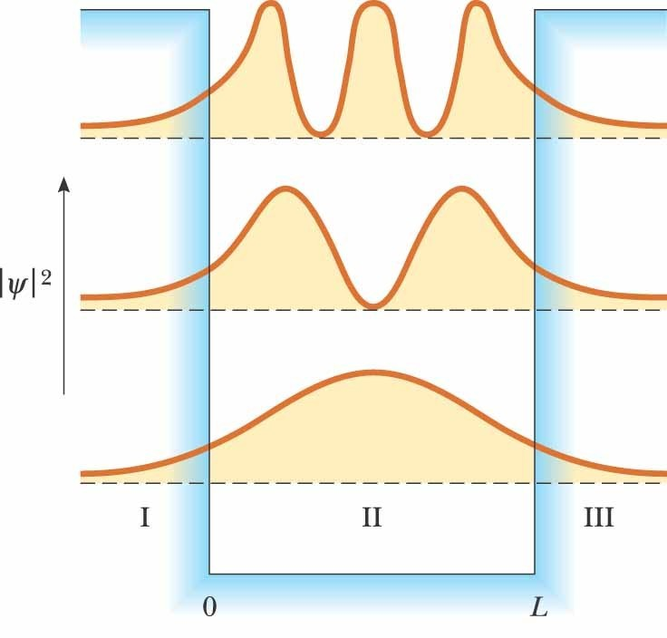
Finite Potential Well

Slide 49
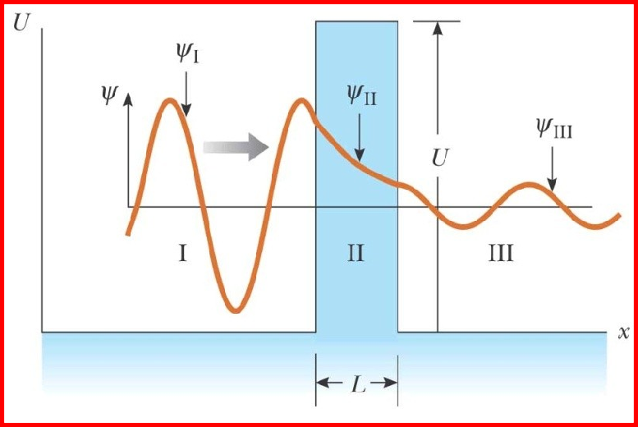
Tunneling
The potential energy has a constant value U in the region of width L and zero in all other regions
This a called a barrier
U is the called the barrier height. Classically, the particle is reflected by the barrier
Regions II and III would be forbidden

Slide 50
Tunneling
According to quantum mechanics, all regions are accessible to the particle
The probability of the particle being in a classically forbidden region is low, but not zero
Amplitude of the wave is reduced in the barrier
A fraction of the beam penetrates the barrier

Slide 51
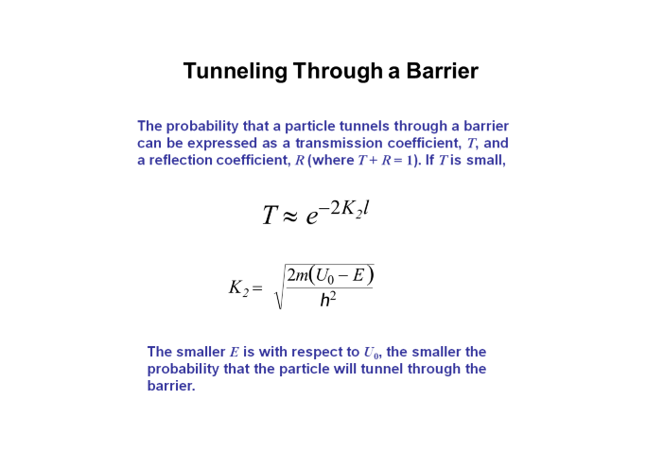

Slide 52
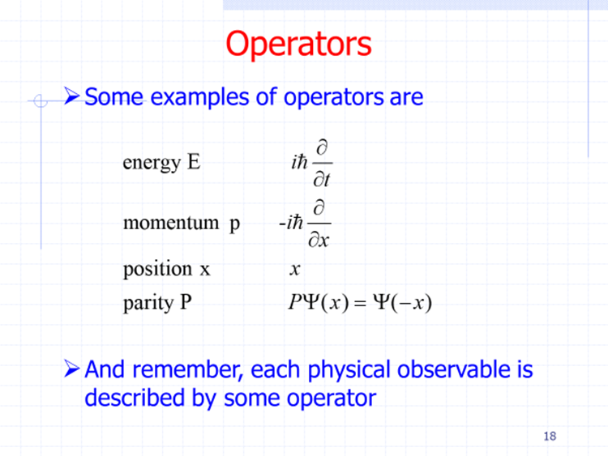

Slide 53
Determine the normalization constant A. (b) What is the probability that the particle will be found between x = 0 and x = L/8 if its position is measured?

